Slide 1

The Communications Climate is Changing.
Are you Ready?
Marti Tedesco
Vice President of Marketing
Peninsula Open Space Trust

Slide 2
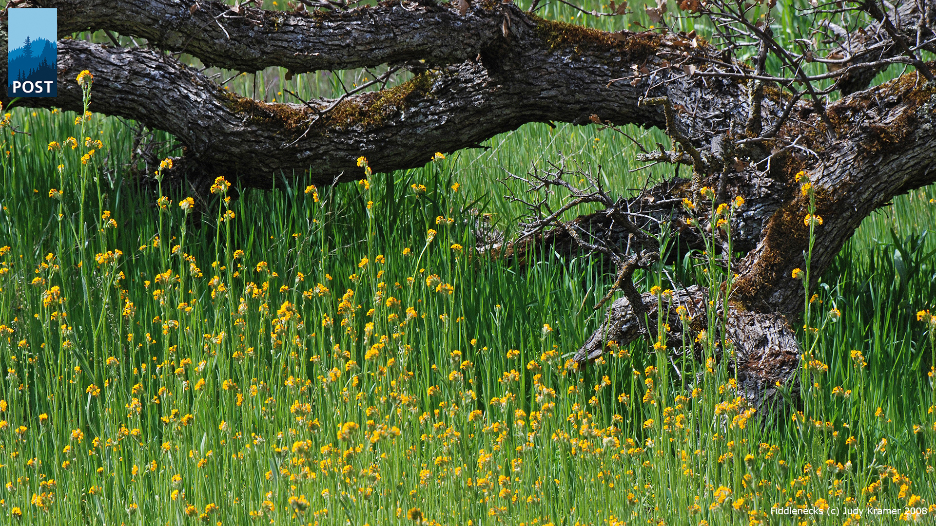
The Happy Wanderer
Notes:
My name is Marti Tedesco.
I work for POST and had the great good fortune to have grown up in a place that looks like this and I’m lucky to get to live in this landscape still.

Slide 3
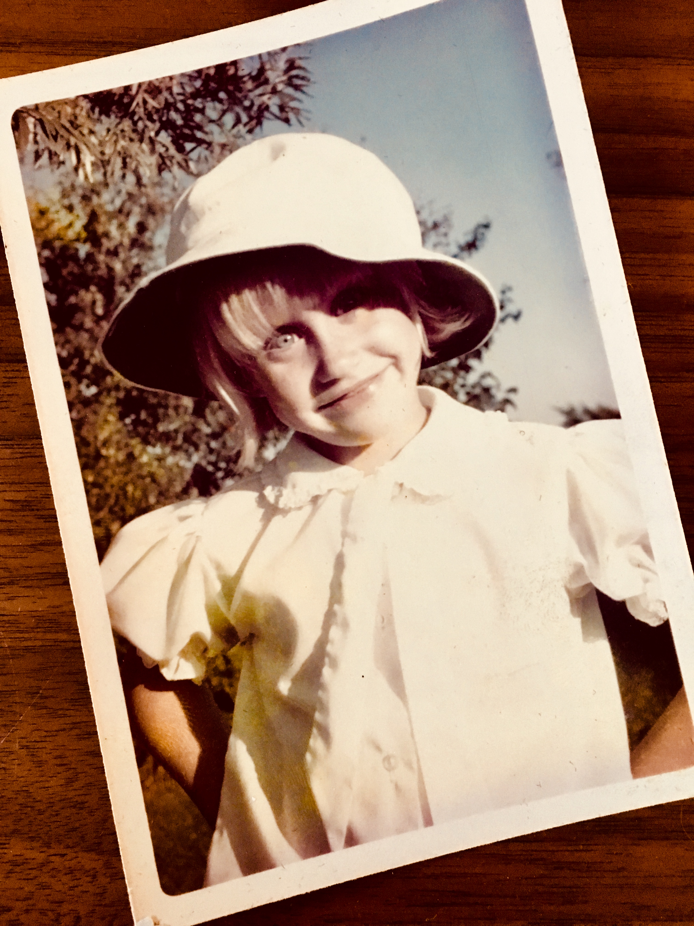
Notes:
My connection to the outdoors and to our natural open spaces started early as I spent my first decades either in a swimming pool, riding horses or running in the great outdoors.
For over XX years I worked in high tech marketing in Silicon Valley.
After taking “10 years off” to raise our two sons, I went back to “work” and soon after landed at POST.

Slide 4
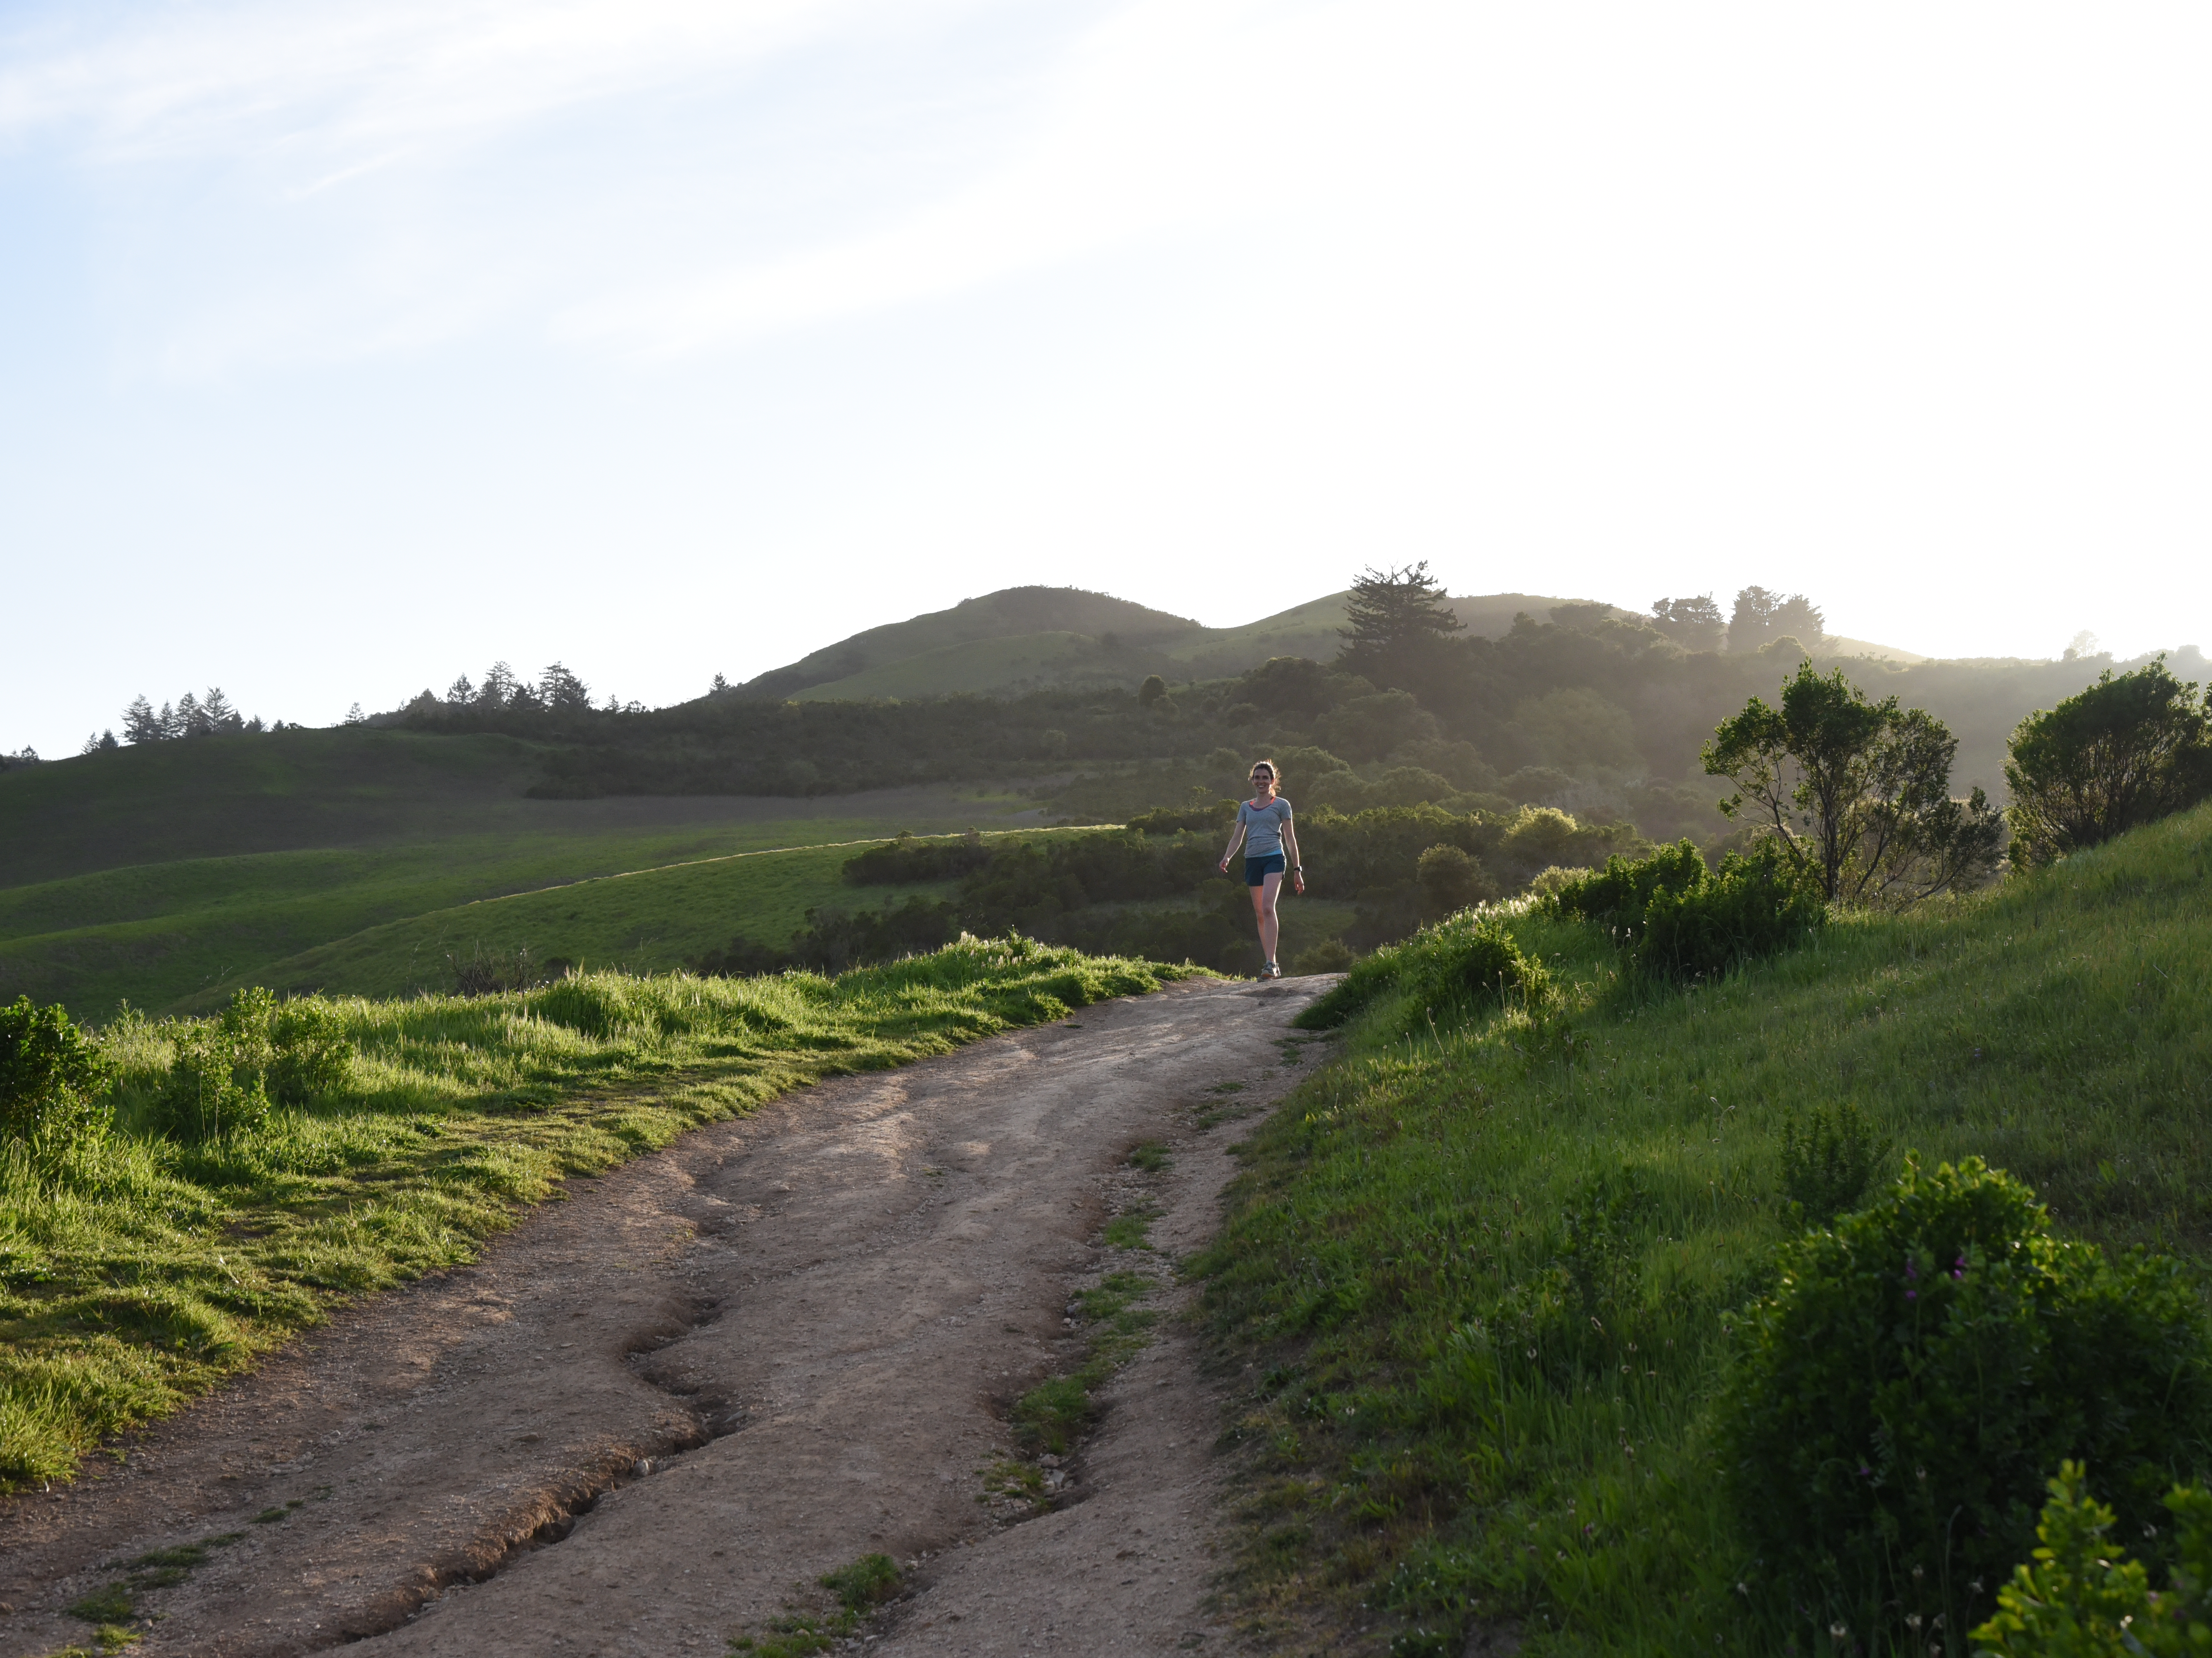
Pic of Windy Hill
Notes:
Now Windy Hill, a beautiful 1,132 acre preserve was POST’s first project and over the years the hill and property itself have become a landmark of the Peninsula and Bay Area.

Slide 5
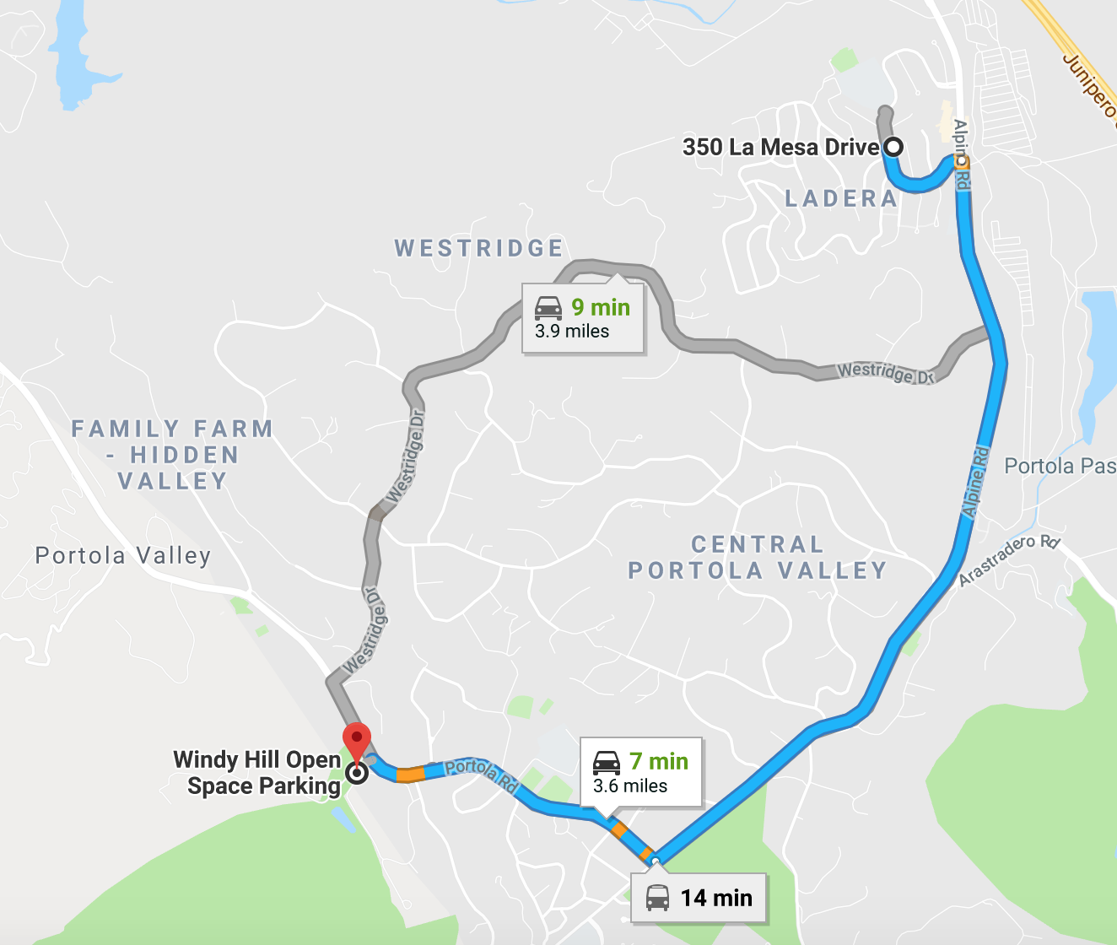
7 minutes, but a world away
Notes:
Now as I mentioned, I have the great good fortune to live in this area. A whopping 7 minutes from Windy Hill.
And prior to joining POST, I had been a donor inspired by my connection to Windy Hill and encouraged by an audacious $200M, 20,000 acre campaign called Saving the Endangered Coast that POST ran in 2001.
But when I started to interview with them, I realized I had not seen or heard of them in years….

Slide 6
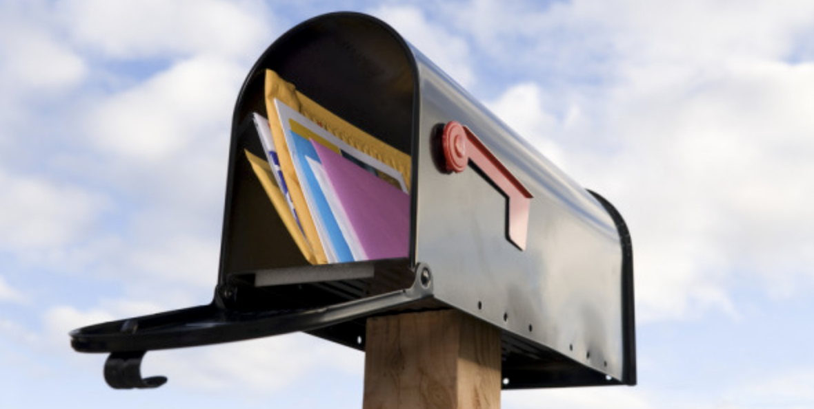

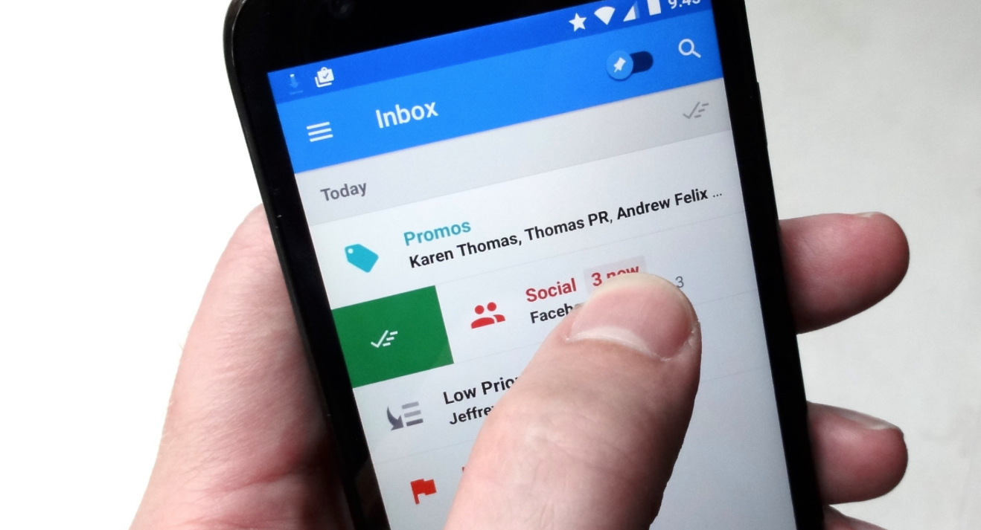
Notes:
So onlyy seven miles away, but when the rest of the world moved from the mail box
To the inbox, POST never followed.
SO by the time our communities in Silicon Valley moved from the inbox to their smart phones, we were really behind.

Slide 7
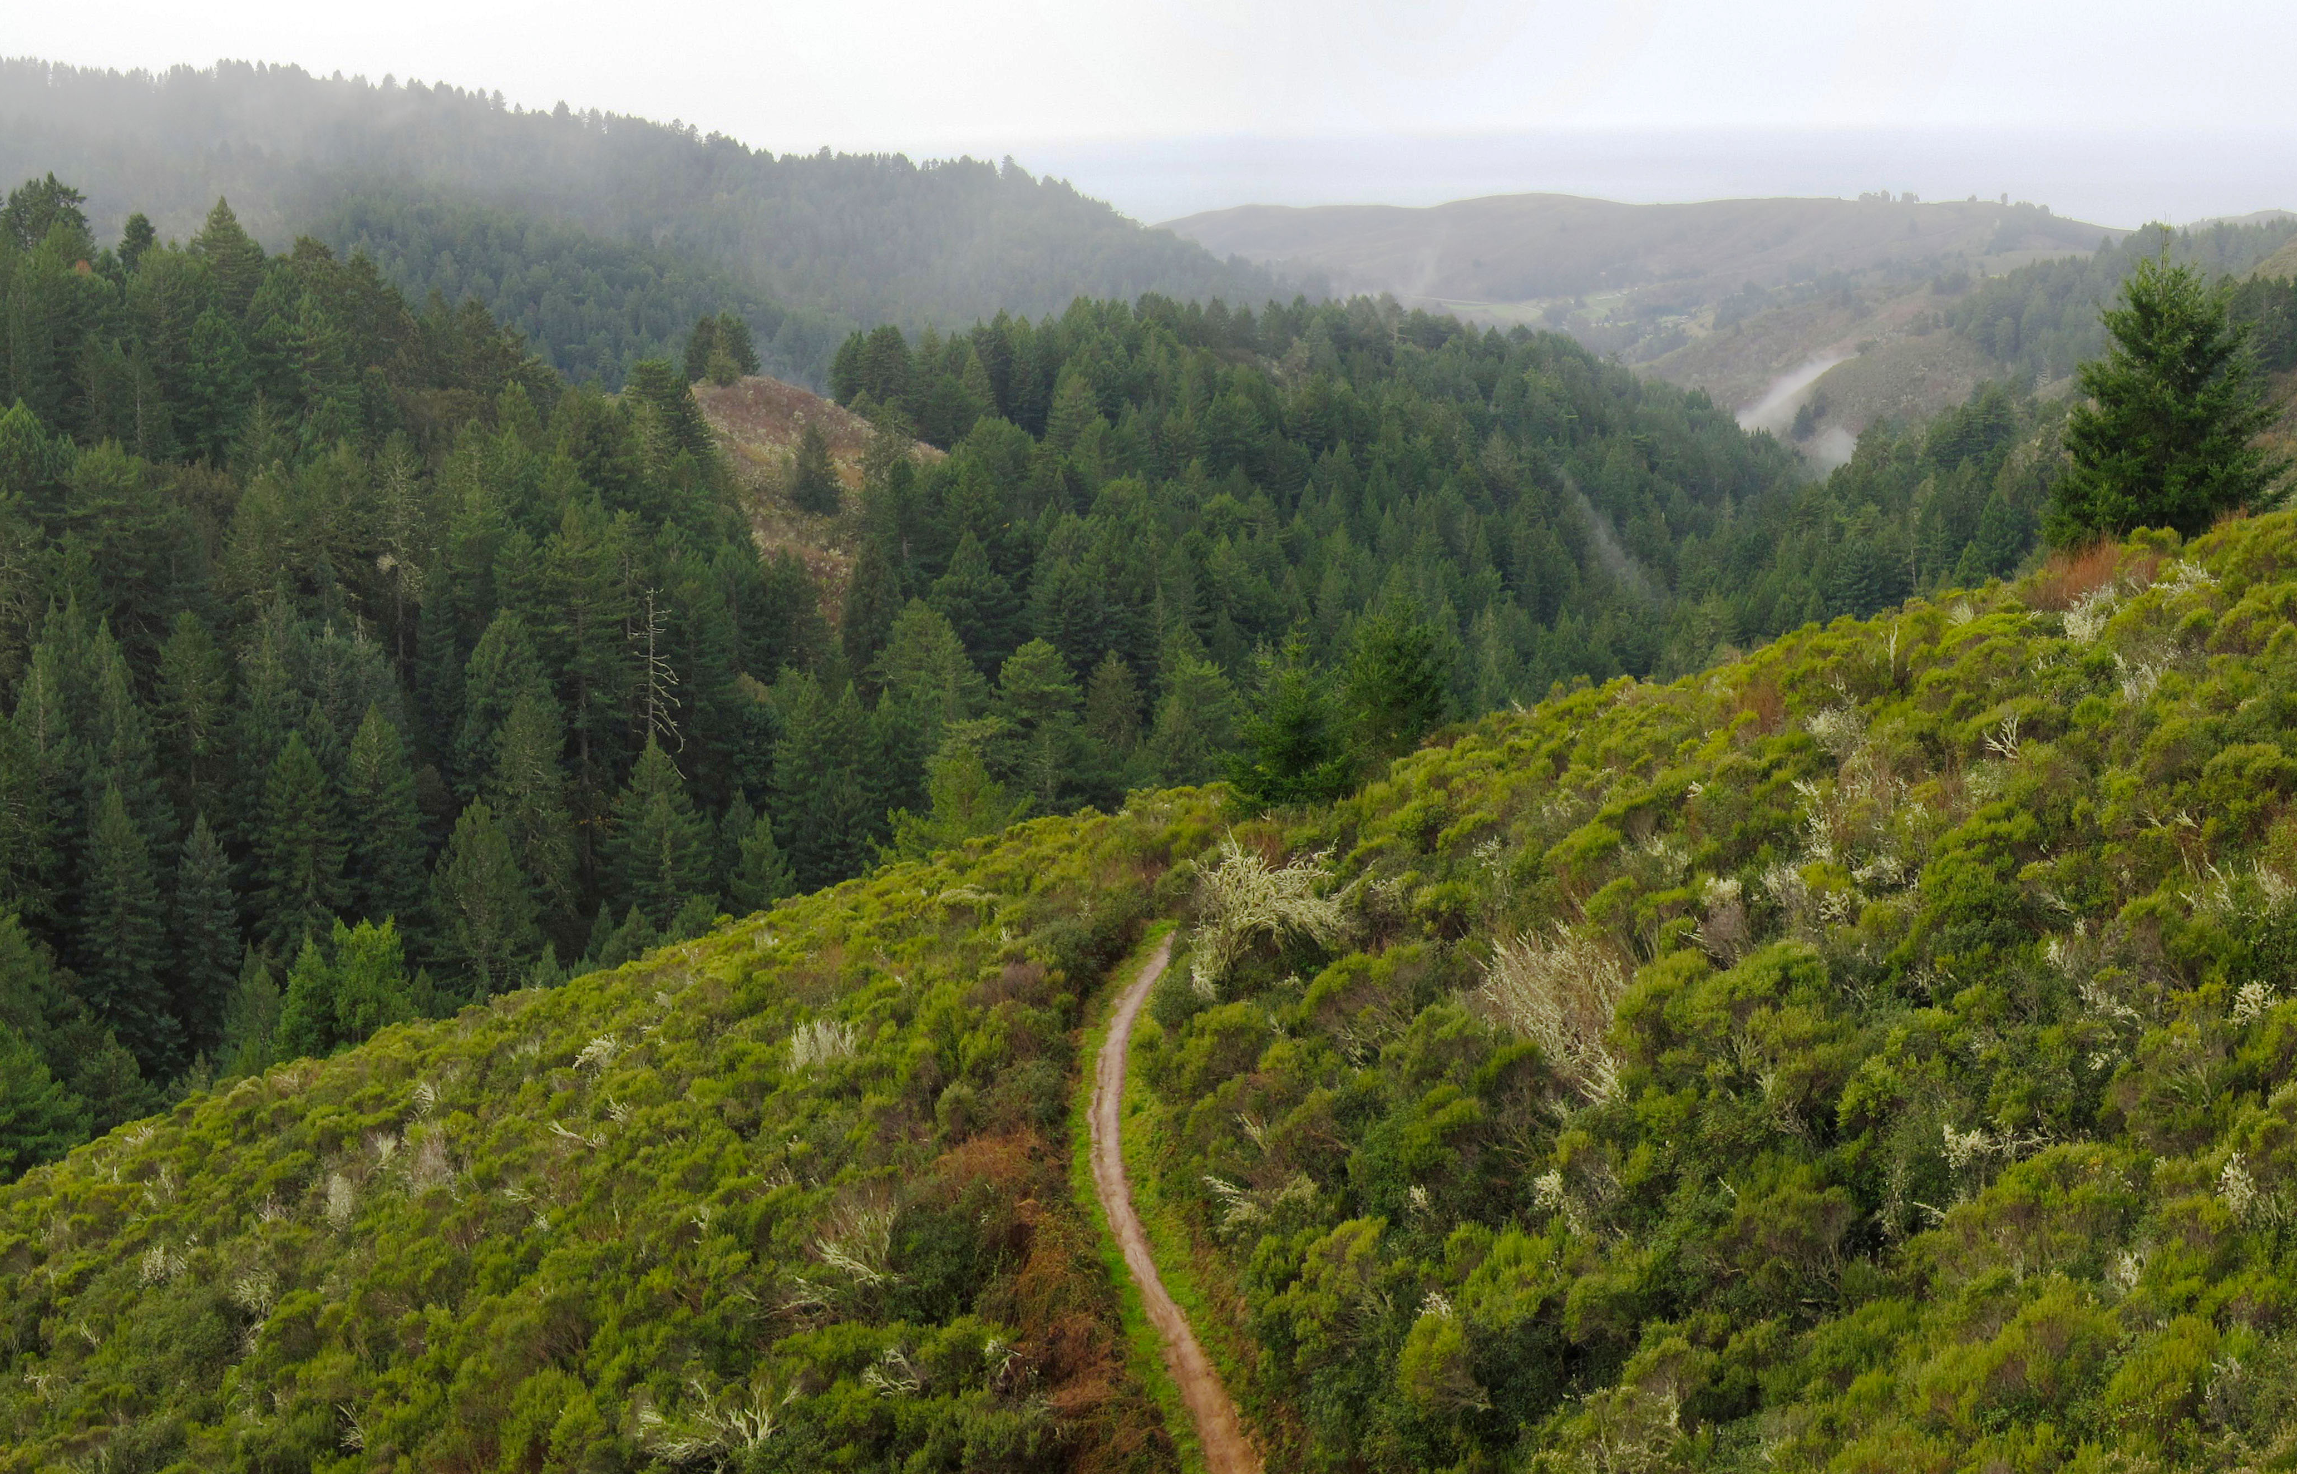
Notes:
And that is where this story really begins.

Slide 8
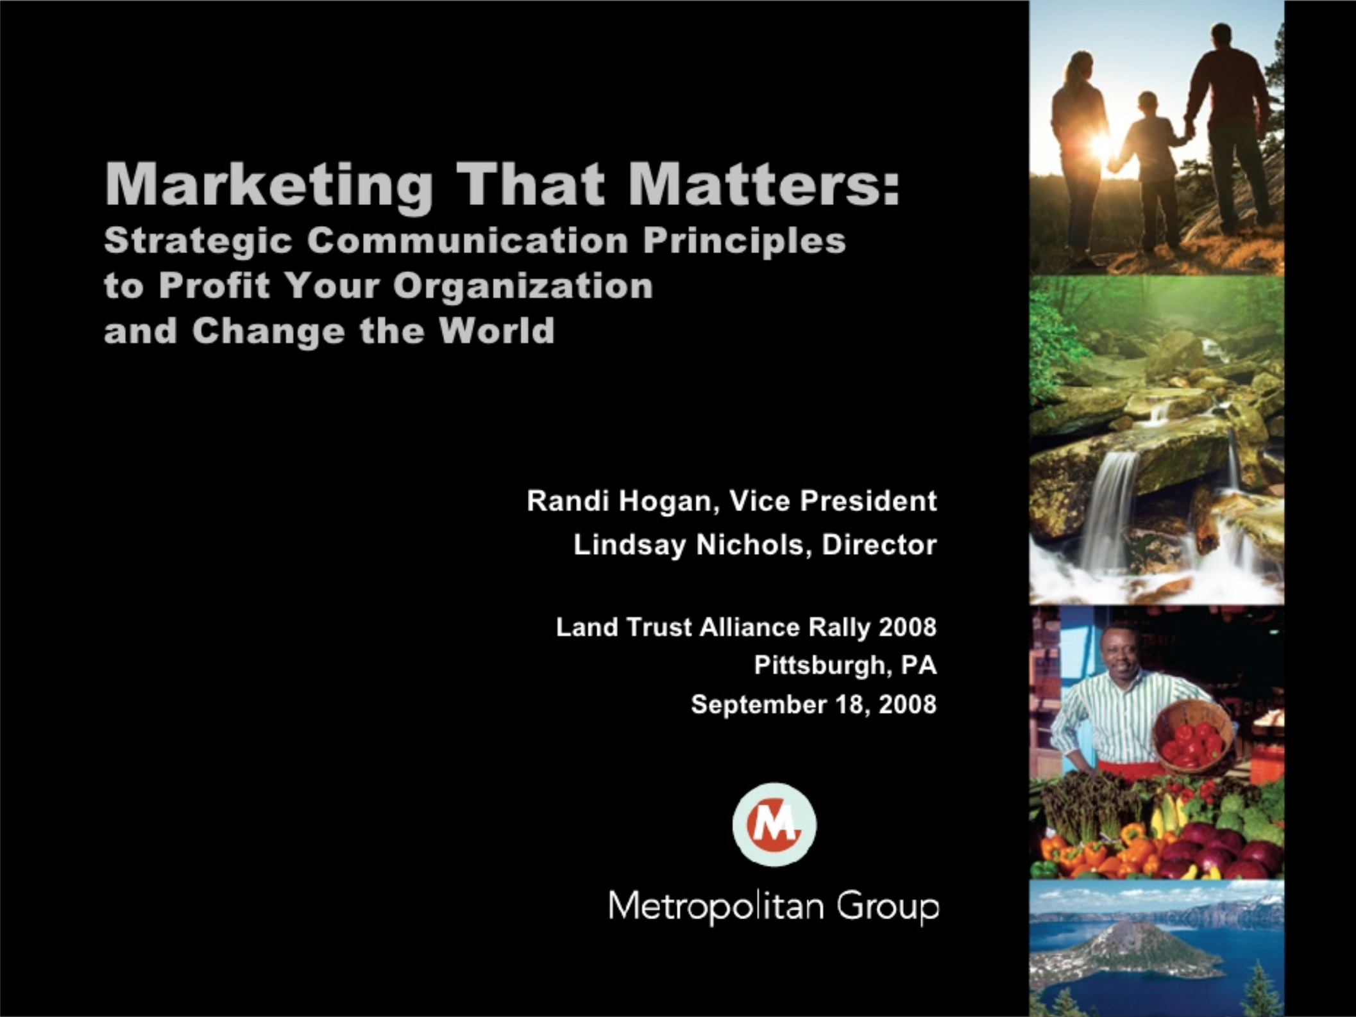
Notes:
I took the liberty of snooping around online and found this presentation from CCLT just 10 short years ago and it covered some really important topics such as audience mapping, message development and how to build a communications plan.
Am I safe in assuming that we are all well past that now?
It almost seems quaint now looking back at how simplistic it all sounds especially given the realities of today.

Slide 9
Since 2008
Cell phone users have grown from 165M to 238M
65% of all US digital minutes are spent on mobile
US households with social media profiles is up from 24% to 81%
78% of all emails are read on a cell phone
56% of Americans agree that the environment is a priority
Sources: Statista 2018,ComScore Mobile Metrix 2017 IBM Marketing Cloud (2016), American Climate Perspectives Annual Summary 2017
Notes:
In case you were wondering how fast things have changed in the realm of marketing here are just a few highlights.

Slide 10
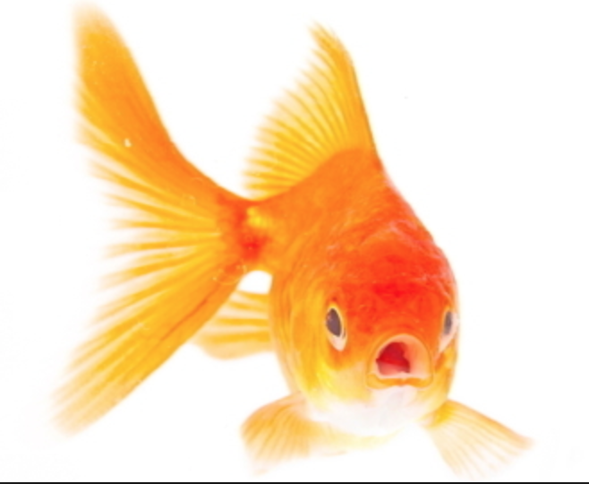
Notes:
And, to make matters worse, some would agree with a 2015 study by Microsoft that when it comes to getting your brand in front of people, we all now have an attention span that is a maximum of 8 seconds – or roughly equivalent to that of a goldfish.
So in 2018, the climate for marketing and communications has changed, and it continues to change, rapidly. It’s a challenge, even for the most astute and well funded among us.
We battle daily for the mindshare of our constituents in order to establish our brand, build a sense of trust, raise money and ultimately further our goals of land conservation.
So the marketing challenge is this – how to get your cause in front of your supporter or donor in today’s rapid fire, noisy marketing environment, and inspire them to back your cause.

Slide 11
1. To further your mission, you must market on some level – either to gain support or raise money.
2. You know a lot about land conservation or fundraising, but maybe less about marketing.
3. If the above is true, on some level, you think that marketing just kind of happens.
4. You have limited time, staff and budget.
Notes:
This is my first presentation at CCLT. As a newby, I want to check a few of my assumptions with you first before we go further.
When I put together this presentation, I used the following assumptions:
So today I want to break marketing down to some very affordable, elemental things you and your organization can do now today to modernize your communications strategy and adapt to our noisy, complicated, data driven world.
So here we go – the top 5 things you can do today

Slide 12
1. Understand the Journey
Build Awareness
Grow Community
Engage
Convert
Notes:
Step One – The Basics
How many of you have seen this model before?
(depending on how many use more or less time)
Great – this picture is referred to as the marketing funnel. Other might know it as “the buyer’s journey” – its the experience that someone goes through from their very first impression or awareness of your brand to that point at which they are willing to part with their own hard earned cash in exchange for a bit of what you have on offer.
the reason the “marketing funnel” is important is that almost everything you do as a marketer needs to align with at least one or more of these phases of the journey

Slide 13
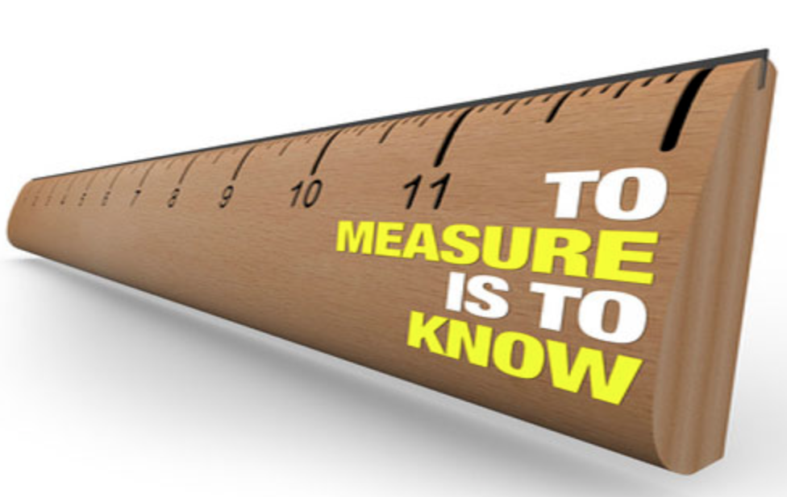
Build Awareness
Paid ads digital and print, email, events, news
Grow Community
Sign up, download, like, share,
Engage
Opens, clicks, visit, attend, comment, share, invite
Convert
Donate
Notes:
Am I telling you things you already know? If so, let’s move faster.
Here are some of the basic things you are already doing to build awareness, grow your base, engage them and convert them to supporters.
But what are you doing now to measure whether or not you are gaining ground?
More than anything, todays digital platforms allow you to easily measure how your marketing efforts are performing. Your best bet is to define the one maybe two important things you want to track for each of these stages and then, simply start. Many of the tools for measurement are free – from google analytics to your social platform dashboards. Take the time to learn them, understand what they are telling you, and return to them frequently
Create a practice where you allow time to define your key performance indicators (or KPIs), and time to track them. Use the data to quickly adjust your strategies – optimize for what’s working and pitch what isn’t.
Measurement today is dynamic. Make sure you are doing it at least monthly- don’t set it and forget it.

Slide 14
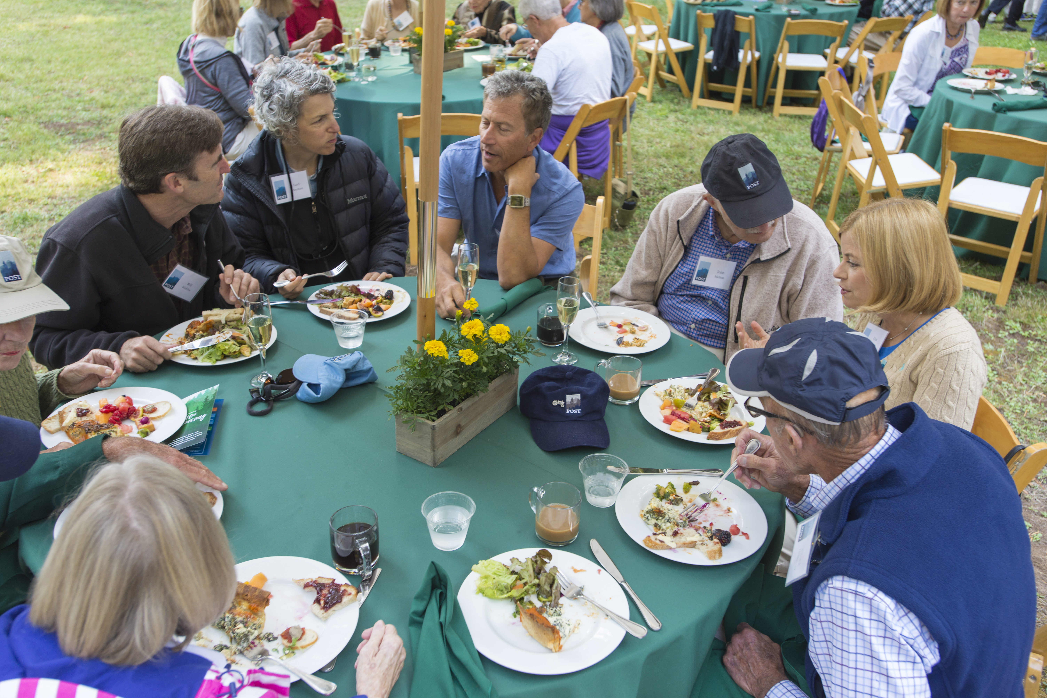
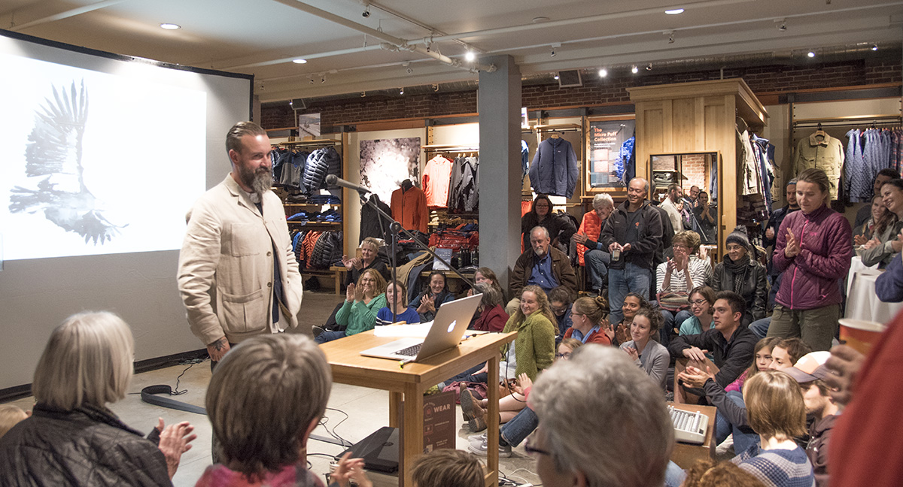
2. Know Your Audience
Notes:
I mean not just who they are or where they are geographically – let’s assume you know that. I mean “WHERE” are they? Where are they in life? Where are they online? And how do they want to connect with you.
Here’s a good example. This first shot is of our long time donors at a specific donor event. You will notice some things about this picture right?
Look closely at this second image…..I see some similarities in the foreground, but look closer and you see some differences. The difference is that the first event was more about donor recognition. The second, was about generating awareness for POST and engaging our community with our work. Two different stages of the journey.
At POST, we look not just at who is donating today, but also at who connects with our mission and might donate tomorrow. In both cases, we filled the room, but HOW we filled it was different. In the first picture – we focused on print and personal invitations.
In the second, we partnered with a local store – Patagonia, and a very cool cat named Obi Kaufman – author of the best-selling California Field Atlas and promotion of the event was entirely digital.
In other words, we met both audiences where they are – long time donors in their mailbox, and our newer community members and donors through email and social media. By the way – 61% of the attendees to the Obi event were brand new to POST, so we find that our existing supporters also like the new format and like to learn about us through digital channels too.

Slide 15
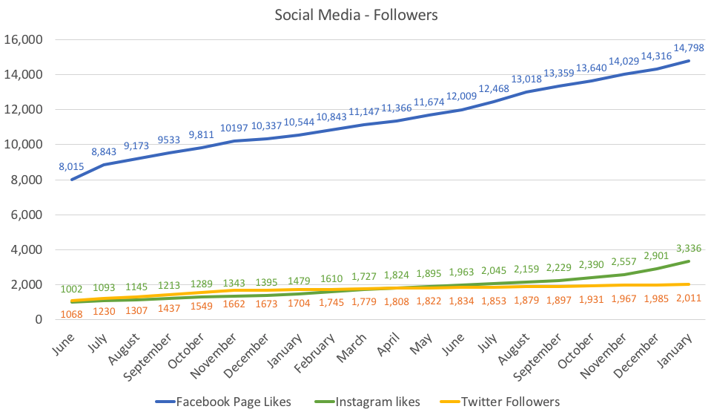
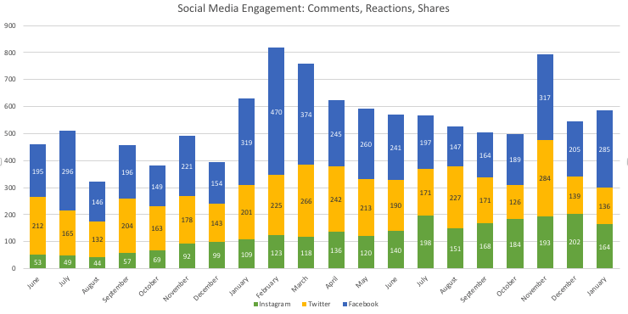
Where are they?
Notes:
For us, our audience, regardless of donor or community are on three primary social media platforms – Facebook, Twitter and Instagram. And we take time each month to look at both how well these platforms are working for us in terms of awareness/reach. We also track how well the platforms are helping us to engage our followers.
We also build in time after our events like the ones you just saw, to understand how many current community members and donors we are reaching and how many new. This isn’t a passive act. Imagine, if you went back to see how a specific land treatment such as invasive plant removal was working. Gathering that data takes expertise, time and effort, but it is vital to inform what tactics you take next.
Use the data you can find within all of your platforms including email and use it to tell you what is working and what is not. From there, its pretty simple – do more of what works, and have the courage to pitch what doesn’t.

Slide 16
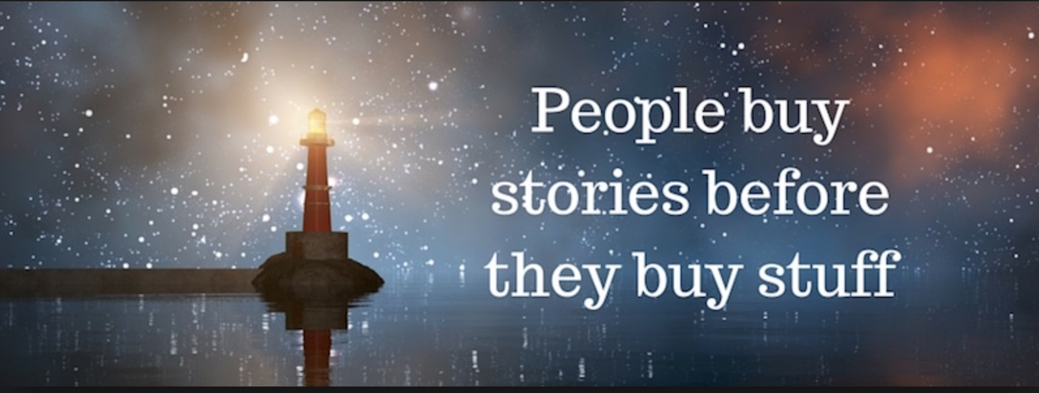
3. Find Your Voice
Notes:
Ok – so now you know who you want to talk to, and where they hang out, now what do you want to say to them? Well first off, it is important ot understand what your voice is. For your land trust, for your geography, and in a way that your audience either likes or is used to hearing from you.
When I came to POST in 2015, our voice was antiquated. We sounded old, inspiring, but old. Our language was stilted and sounded a little too Downton Abby (upstairs) for Silicon Valley circa 2015.
So we worked to modernize our tone, our lexicon and the look of our materials.
But what is so important is that what you say and how you say resonates with who you really are.

Slide 17
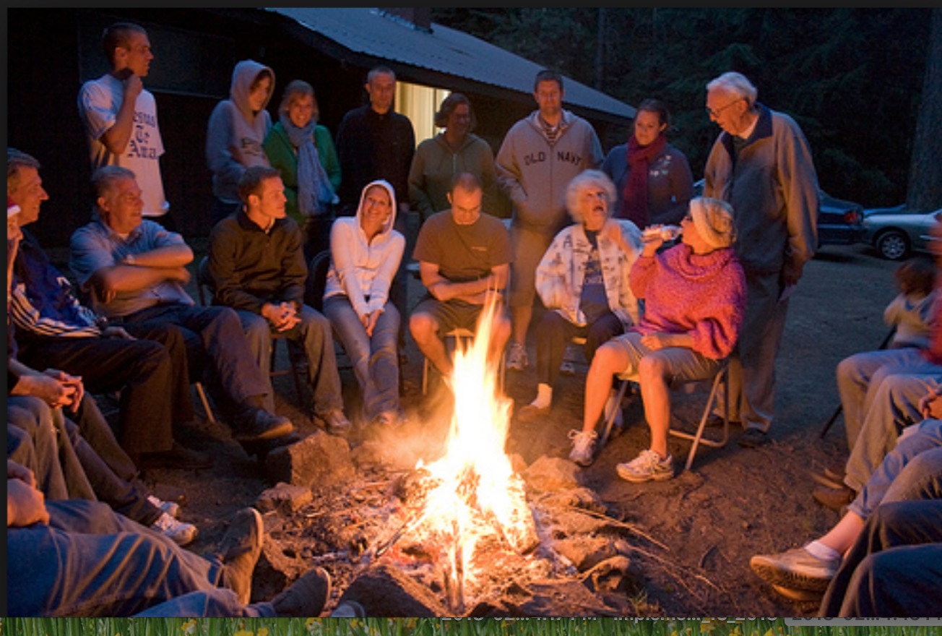
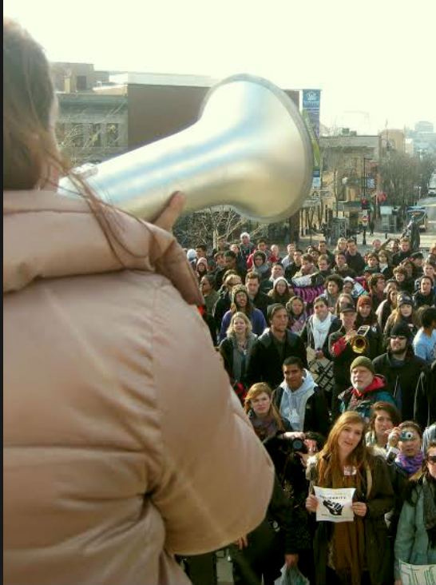
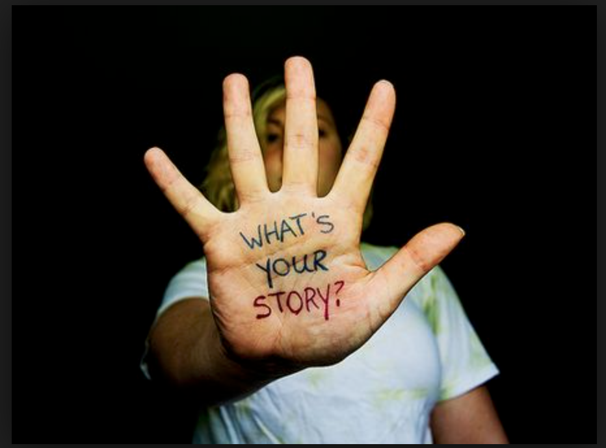
Notes:
There are so many types of land trusts – from broad national organizations to hyper local organizations. Those who’s mission includes advocacy and those who lean towards education. Those who are raising money to buy land (and who isn’t?) and those who raise money for land projects or both. Regardless of the type you are – make sure your voice reflects both who you and your donors truly are today as well as what you want to be.

Slide 18
4. Tell Great Stories
1. Good stories are good stories
2. Use simple language
3. Think in pictures not words
4. Did I mention video?
5. Spread the word everywhere
6. Think digital first
7. Be smart about email
8. Do it all over again
Notes:
Now I know that when we talk about content development, it can make even the most creative of marketers blanch. So here are some really easy tips that will hopefully make it accessible for all of us.
If its interesting to you – its interesting to others. Face it – we do cool stuff! Project work, transactions, campaigns, donors, seasonal things of interest in your neighborhood and on the land are all great fodder for stories.
Keep it simple. We like to get all scientific and wonky, but our audiences maybe don’t follow that as well. So keep your language as simple as possible. That also makes it really easy to deploy across channels like social media where you only get a few characters and a teeny tiny photo to get your point across. Don’t let perfect be the enemy of great when it comes to content.
Imagery matters – now more than ever, it REALLY MATTERS! Remember that thing we just talked about attention span? Well, if you are a land trust, then what you are selling is typically pretty beautiful. Invest in great photography, in a decent camera and if that doesn’t work for Gawd sakes, just get out your phones and encourage members of your team to do the same. Even if you just house them in a simple file sharing account set on up and have everyone dump their imager and video there as a start.
Did I mention Video? So many of us think of video in terms of the soaring, inspirational land trust story that usually take a lot of time and money to produce. The good news is that today with social media and blogs, not only do you not need all of that, but its likely no one will watch. Let me show you an example of something we did and this will literally, only take a minute…. (show minute with matt)
One last thought on images and video p they will help to connect audiences to your work, but you must be careful to create images that leave gender, race, and other specifics open to interpretation. If you only show pictures of one type of constituent, over time, you will not connect all of the people in the community you want to connect with. We continue to struggle with this, and are working hard to ensure we do better
So where do you put this content? Of course you post it on social media – but you may not use the same version on each social channel. Be sure to check the types of audiences that follow you and adjust from there. But more than anything, housing this content on your website will ensure that a) its all in one place b) you can connect to it from everywhere and c) its there when you want to redeploy it.
So thinking digital first means you design and think about every piece of content from a digital perspective before you think about print. Its much, much easier to adjust digital for print mediums than it is the other way around. And, if you are tight on budget, my personal perspective is that you work to minimize print in general – it is infinitely ore expensive and time consuming than digital. It also has a much shorter shelf life and who wants that?
Thinking digital first also supports that old tried and true – email. Now I do not expect everyone in marketing to be 100% up on the latest trends in email, but suffice it to say that with all of those people reading email on their phones, your email has to be mobile optimized. It just has to. Second, it needs to be designed well. Invest in a great layout and use it repeatedly. Finally, think about when you send your emails. Timing is important. If you are not sure, ask a few of your loyal supporters about their preferences, try it and then stick to it. A regular cadence of great content, reliably delivered will instill the trust you want in your brand, and keep the dialogue going in a direction you want to see over the long haul.
Finally, do it all over again. Marketing today lives in a 24x7 world – just like your donors, supporters, partners and nature.

Slide 19

…and tell them, and tell them, and tell them…
1. Build great content
2. Use your website
7. Refresh & redeploy
3. Spread the word
6. Replay by channel
4. Measure results
5. Modify based on data
Notes:
Good stories, simply produced, consistently deployed and shared can be the holy grail of any land trust – regardless of size. This content wheel gives you a glimpse of how we approach the challenge at POST.
Take them around the wheel

Slide 20
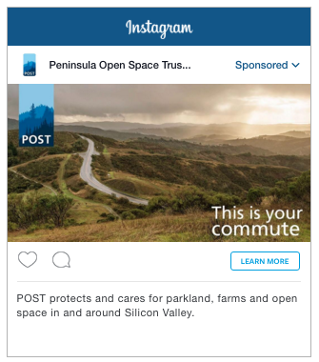
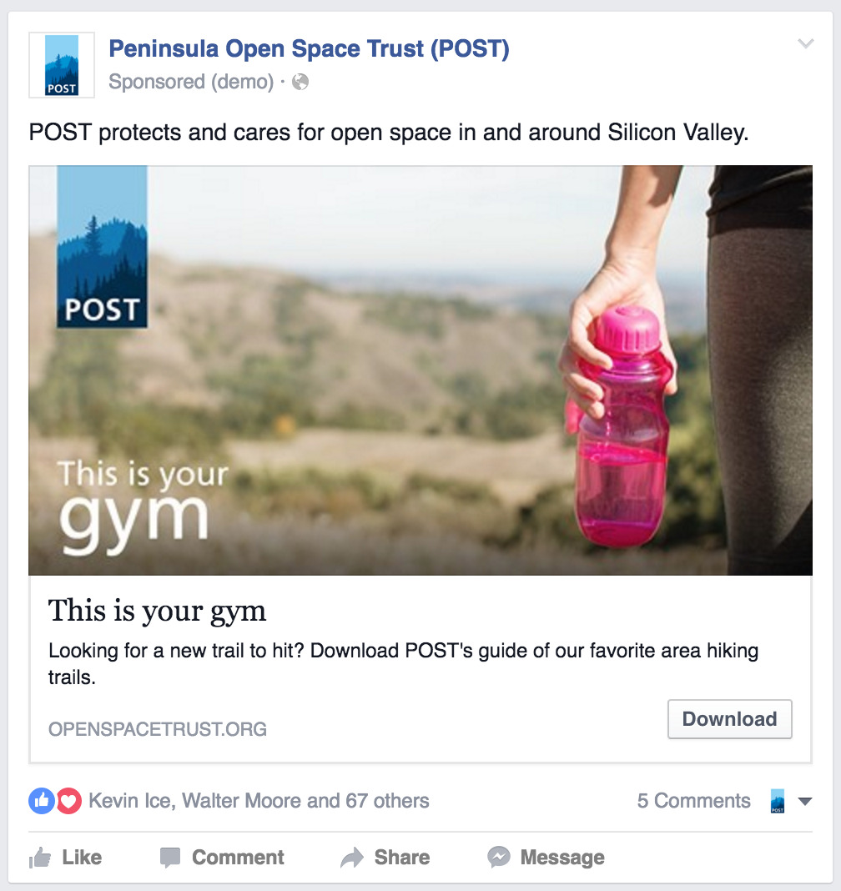
5. Invest What You Can
40%
on content creation
47%
on promotion
3.5X
online vs print spend
Notes:
This is the hardest part – time and money. As I mentioned before, if you are not familiar with marketing, you may think that stories, content and websites just happen. But what we do is really very similar to land work. It involves strategy, patience, money, hands on expertise, contractors, data collection, testing and time.
Many of you may be doing two jobs at your land trust. Many may lack the technical skills, but you can do it. Here is how the typical marketing dollar at POST shakes out.
Oh – and that 40% for content creation? We also recognize that we cannot possibly have all of the skills and hours needed to make our digital, print and video assets. So we use contractors – many of them as much lower cost that full time employees to help with artistic design, web deployment and its possible in many cases to get external help too to run your social and email marketing. Either way, there are resources available out there – you do not need to grow your own or go it alone. If you are stuck – ask for help.

Slide 21
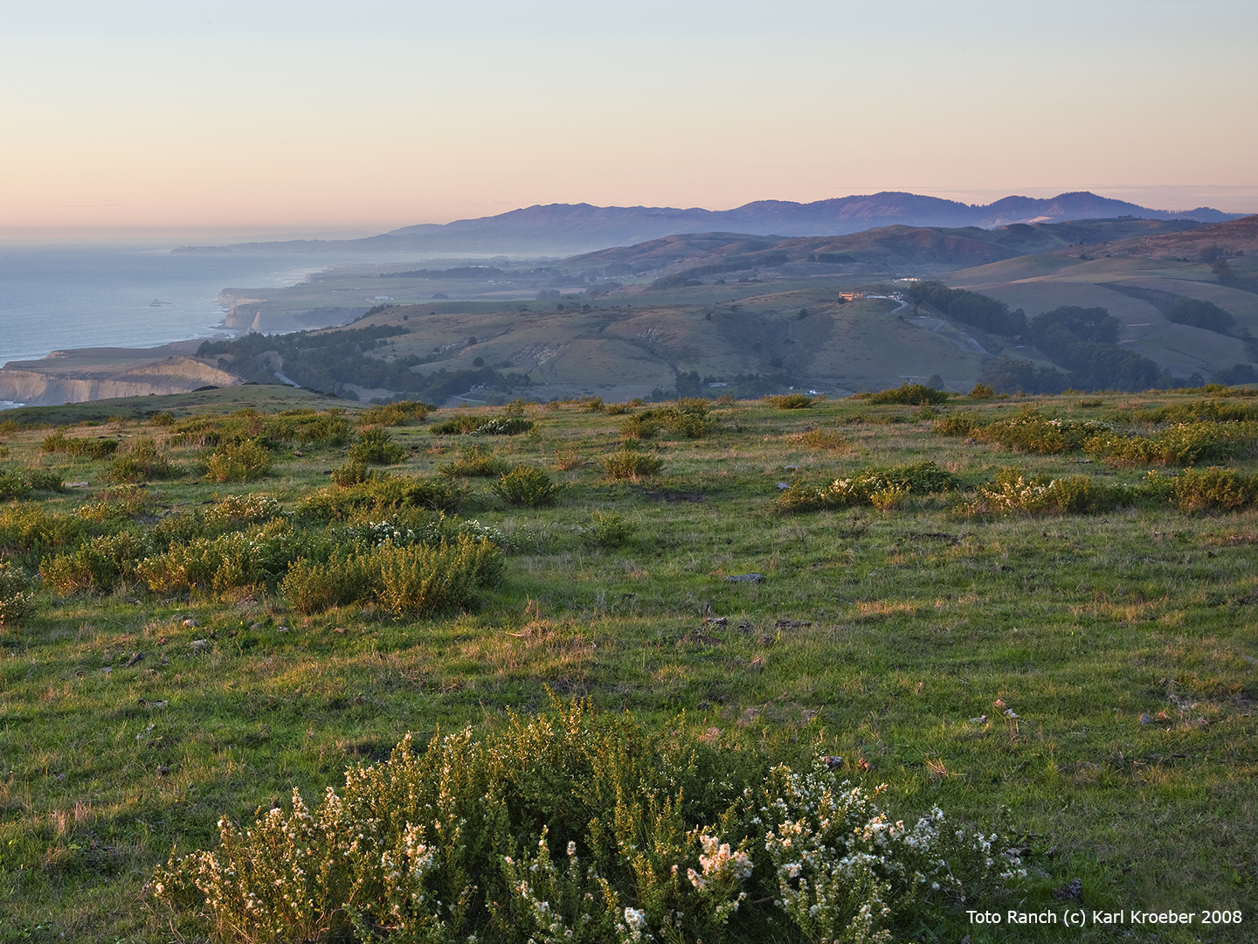
Q & A
Notes:
Thank you for your time and attention here today. That’s all I have and I am happy to take any of your questions.

Slide 22
Resources
http://quicksprout.uberflip.com/i/221478-the-beginners-guide-to-online-marketing/0?m4=

